Slide 1

Understanding
Western Culture
Dave Jaye 2013
Notes:
Today we’re going to talk about culture and how cultural differences impact the way we interact and work with each other.
Feel free to ask questions at anytime or tell me if you don’t understand something I say.
Firstly we need to understand what culture is.
Can anyone give me a definition of what the word culture means?

Slide 2


Western culture ≠ Western Film / TV
(but does influence it)
Notes:
People’s first impression of western culture often comes from Western TV and movies but this can be misleading and enforces stereotypes.
Whilst TV and movies reflect and influence culture to an extent they are not a good indicator
If we believed everything on TV I’d think all Chinese are Kung Fu masters and you’d think Westerners have affairs all the time
There are elements of truth in both but neither is an accurate depiction
So where does western culture come from?

Slide 3
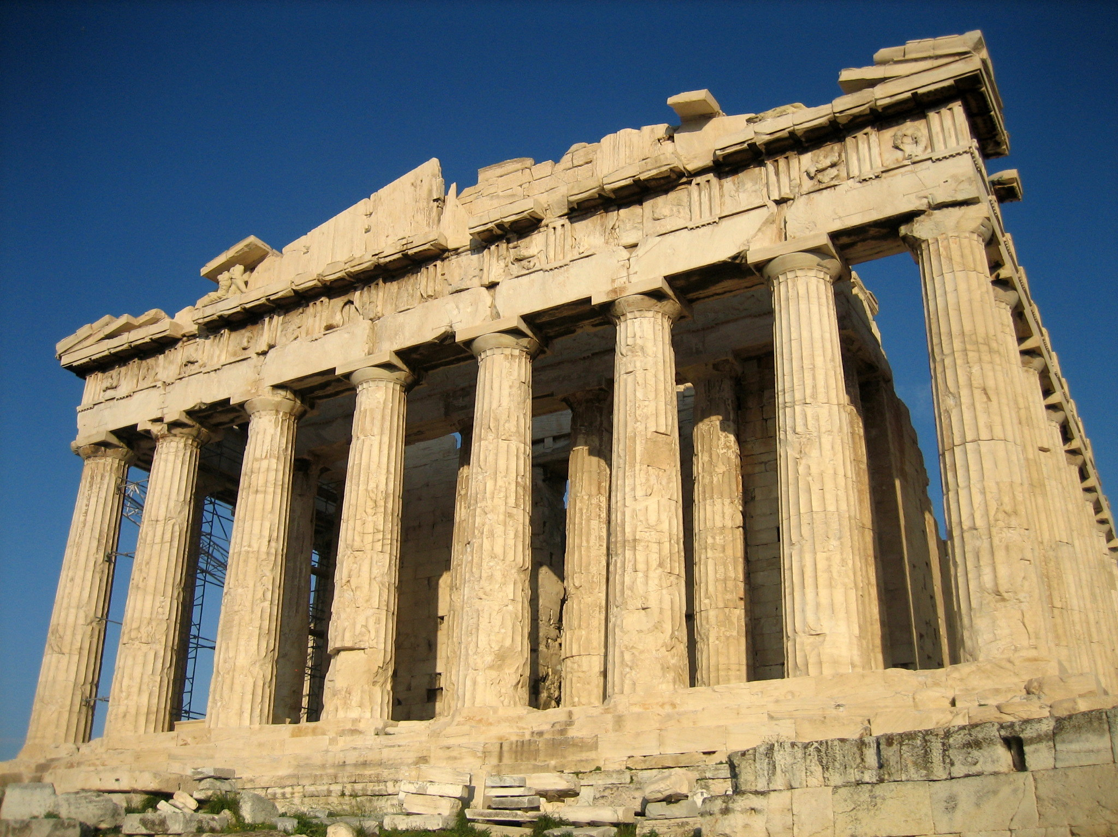
Originates from Ancient Greece (Europe)
Notes:
The ancient philosophers Socrates, Plato, and Aristotle established the foundations of Western philosophy and first considered the meaning of life
Who made me? Why am I here? What is my purpose in life?
They started writing things down and developed early literature.
Constructed monumental architecture to symbolize their power (Acropolis)
Athens was the worlds first democracy with a cosmopolitan world view (international culture).
Developed political, military, social, and religious structures
For all of their brilliant accomplishments, the Greeks were unable to rise above the divisions and rivalries that caused them to fight each other and undermine their own civilization.

Slide 4
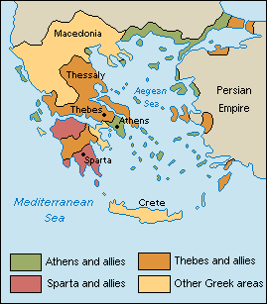
Western Individualism Roots
Greeks city states were isolated from each other and other cultures by mountains and the Sea.
Greeks insisted that each person take responsibility for his actions and life by learning to make correct choices.
Greeks were encouraged to think, act and create with the qualities of a free man--abhor stupid, cowardly, and selfish ways.
Notes:
http://en.wikipedia.org/wiki/Individualism
Individualism is the moral stance, political philosophy, ideology, or social outlook that emphasizes "the moral worth of the individual".12 Individualists promote the exercise of one's goals and desires and so value independence and self-reliance3 while opposing external interference upon one's own interests by society or institutions such as the government.3
Individualism makes the individual its focus1 and so starts "with the fundamental premise that the human individual is of primary importance in the struggle for liberation." Liberalism, existentialism and anarchism are examples of movements that take the human individual as a central unit of analysis.4 Individualism thus involves "the right of the individual to freedom and self-realization".5
It has also been used as a term denoting "The quality of being an individual; individuality"3 related to possessing "An individual characteristic; a quirk."3 Individualism is thus also associated with artistic and bohemian interests and lifestyles where there is a tendency towards self-creation and experimentation as opposed to tradition or popular mass opinions and behaviors36 as so also with humanist philosophical positions and ethics.78
http://public.wsu.edu/~hughesc/individualism.htm
The Greeks insisted that each person take responsibility for his actions and his life by learning to make correct choices--thus the power of individualism is defined in relationship to a community that defines "correct choices."

Slide 5
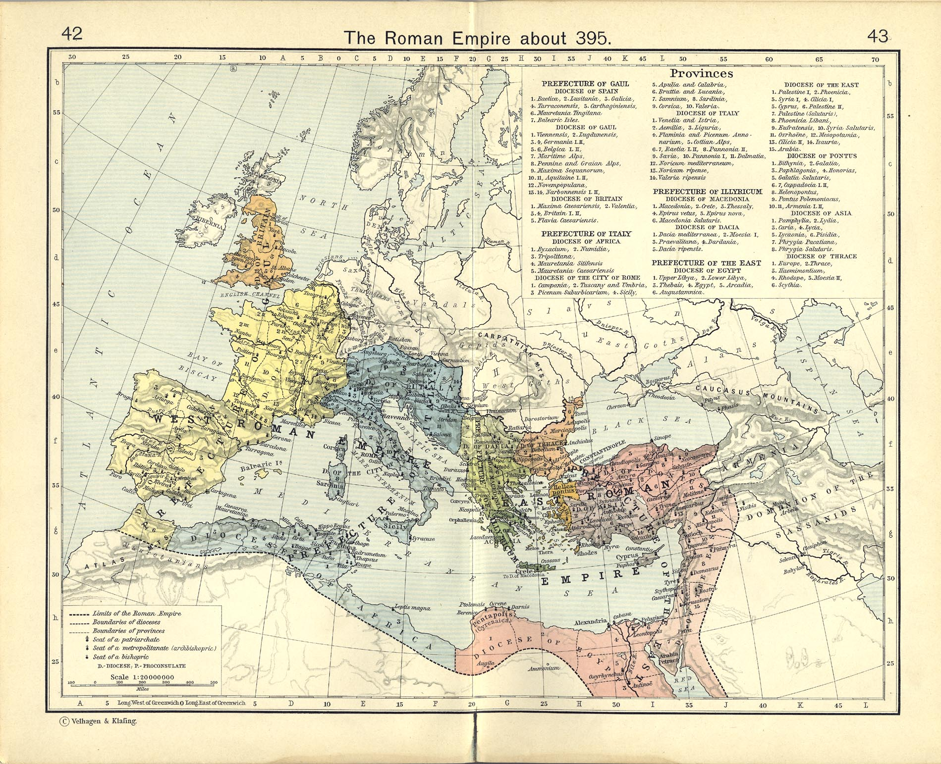
Spread by Roman Empire (1st Century BC)
Notes:
The Romans (from Italy) conquer most of Europe and build roads everywhere – very efficient.
Made achievements in language, law, engineering, and government (introduced coinage, long distance trade)
Become gradually corrupt and stretched too thinly due to invasions, civil wars, and economic decline.

Slide 6
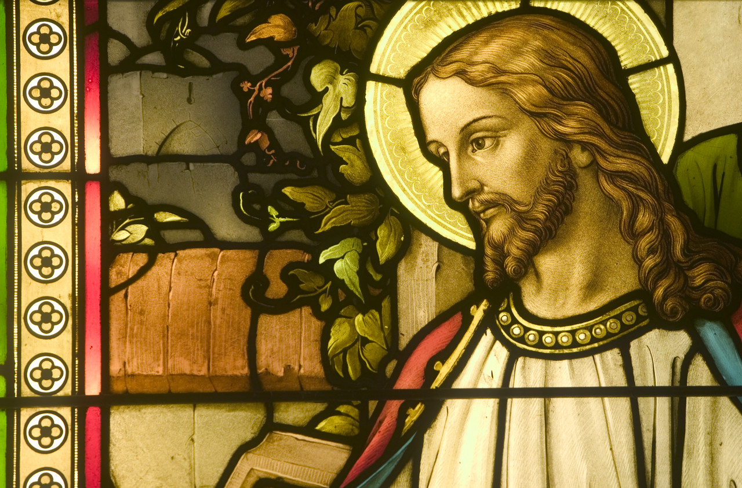
Influenced by Christianity (4/5th Century)
Notes:
Christianity grew and became widely accepted by the fourth century (from Jewish sect)
It was made the official state religion of the Roman Empire.
The Roman Catholic church played a crucial role in the growth of the new European civilization.
The church developed an organized government under the leadership of the pope.

Slide 7
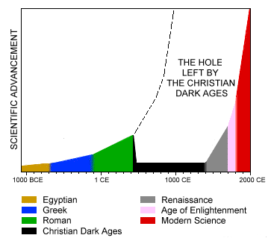
Stagnated during Dark Ages (5/6th Century)
Notes:
But there was a problem… Christianity distrusted science, logic and reason
The Dark Ages were a period of cultural decline or societal collapse that took place between the fall of Rome and the eventual recovery of learning.
“600 years of degenerate, godless, inhuman behavior”

Slide 8
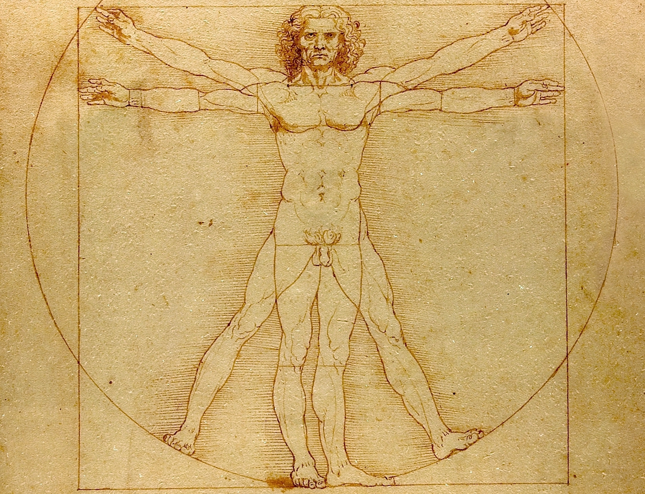
Rebirth: Renaissance (14 – 17th Century)
Notes:
Rebirth of art, education, science & literature.
The Renaissance was a cultural movement that profoundly affected European intellectual life in the early modern period.
As a cultural movement, it encompassed a resurgence of learning, art, and widespread educational reform.
Its influence affected literature, philosophy, art, politics, science, religion, and other aspects
Vitruvian Man – Leonardo da Vinci (ideal human proportions)

Slide 9
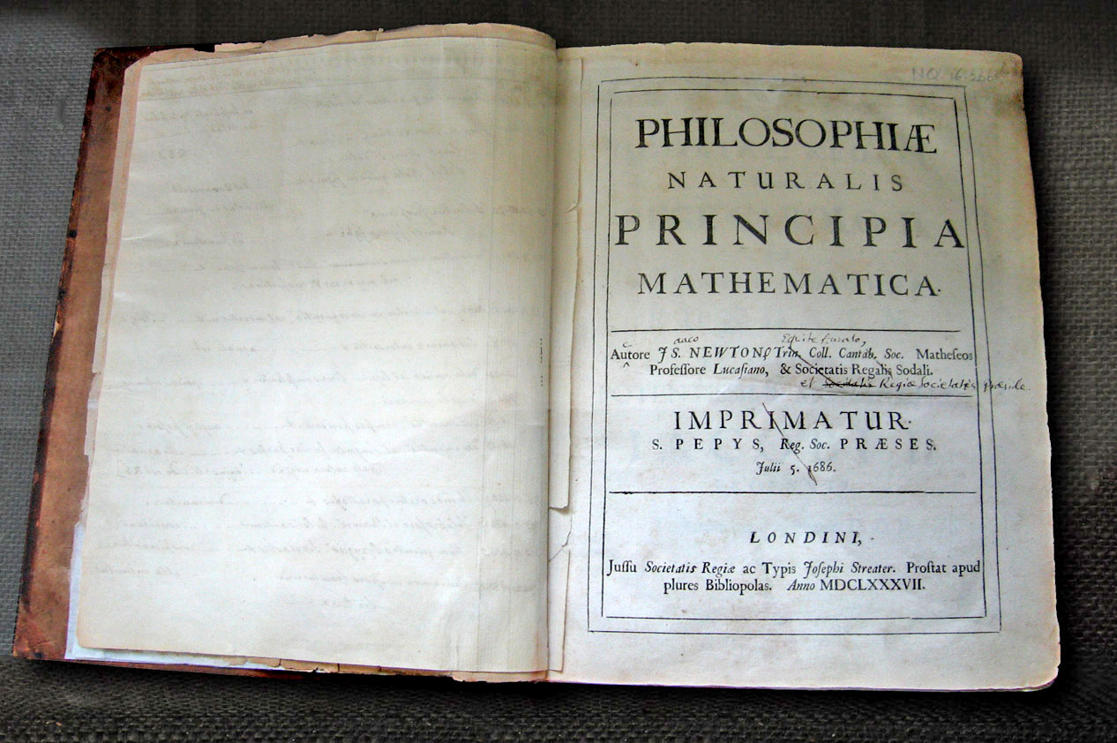
New ideas: Scientific Revolution (17th Century)
Notes:
Rejection of old ideas, beginning to look for new ones. From flat earth to round earth. Religion -> Science/Reason
The scientific revolution was a time when people began to look for the answers to questions regarding the make-up of the earth, and the people living on it.
It was a period when new ideas in physics, astronomy, biology, human anatomy, chemistry, and other sciences led to a rejection of ideas from Ancient Greece and laid the foundation of modern science.
Struck a conflict between ideas of individuals and the ideas of the church.
From the shape of the world to the circulation of blood in a persons body many theories developed to find out how these things worked.
Important people: Newton, Galileo, …

Slide 10
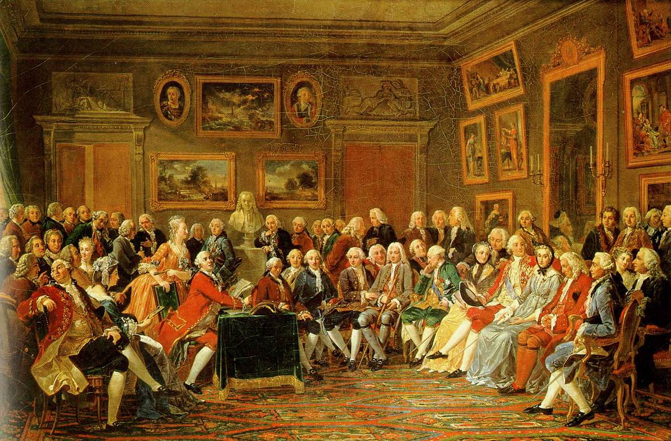
Logic & Reason: Age of Enlightenment (18th Century)
Notes:
A period of time characterized by the importance of logic and reason
“freedom to use one's own intelligence”
Separation from King + Religion
Common people got a voice
They were greatly impressed with the accomplishments of the Scientific Revolution, and when they used the word reason they were advocating the application of the scientific method to the understanding of all life.
Basic challenges to the authority of the king, freedom of speech, press, and religion, and the role of commoners in the government were revolutionary.

Slide 11
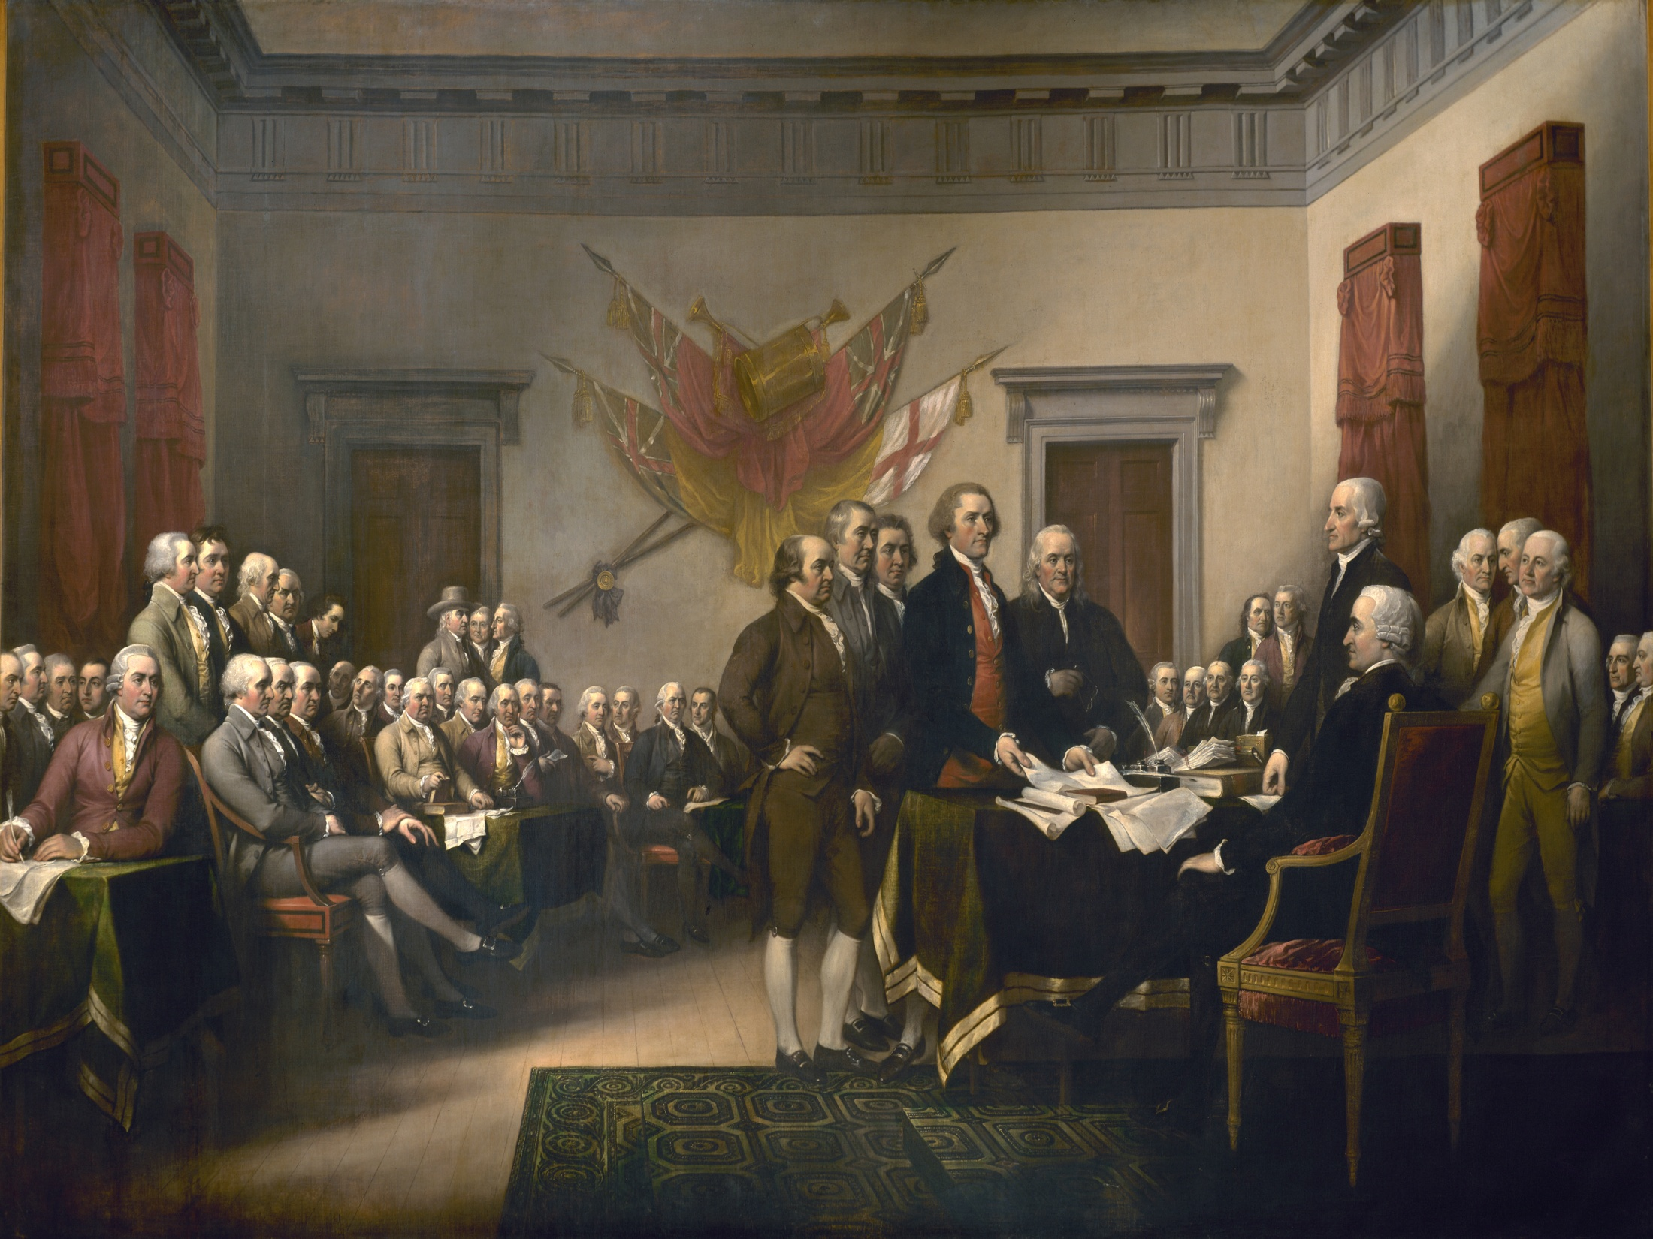
Independence: American Revolution (Late 18th Century)
Notes:
The American Revolution refers to the political upheaval during the last half of the 18th century in which the Thirteen Colonies of North America overthrew the governance of the British Empire and then rejected the British monarchy to become the sovereign United States of America.

Slide 12
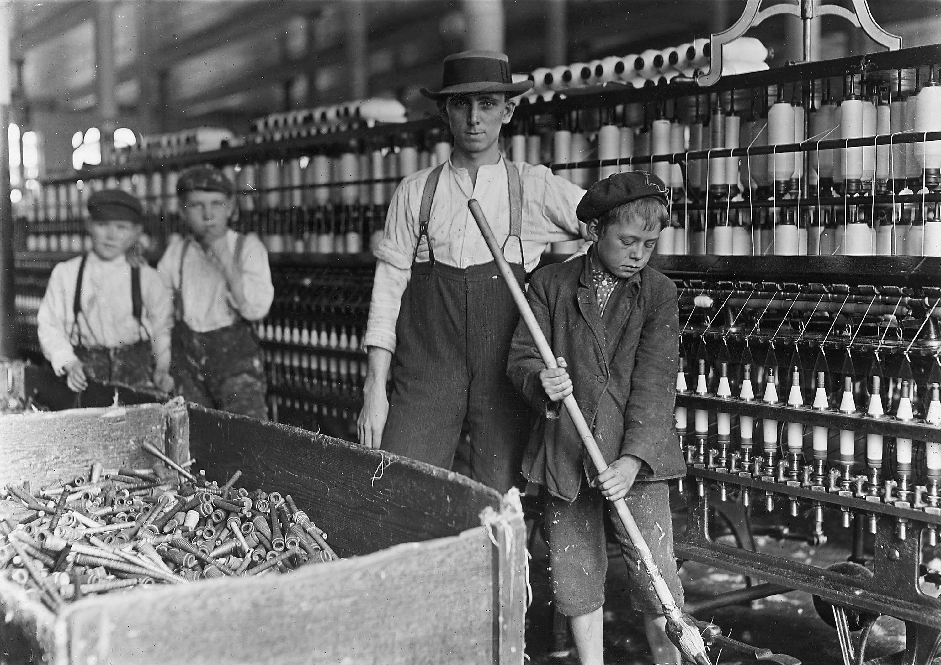
Industrial Revolution (19th Century)
Notes:
Advances in science and technology led to big changes in …
The Industrial Revolution was a period in the late 1800s and early 1900s when big changes in agriculture, manufacturing, production, and transportation had a huge effect on the conditions in Britain. The changes quickly spread throughout Europe, North America, and eventually the world.
Effort to build factories for massive production. Greatly altered economic and social systems.

Slide 13
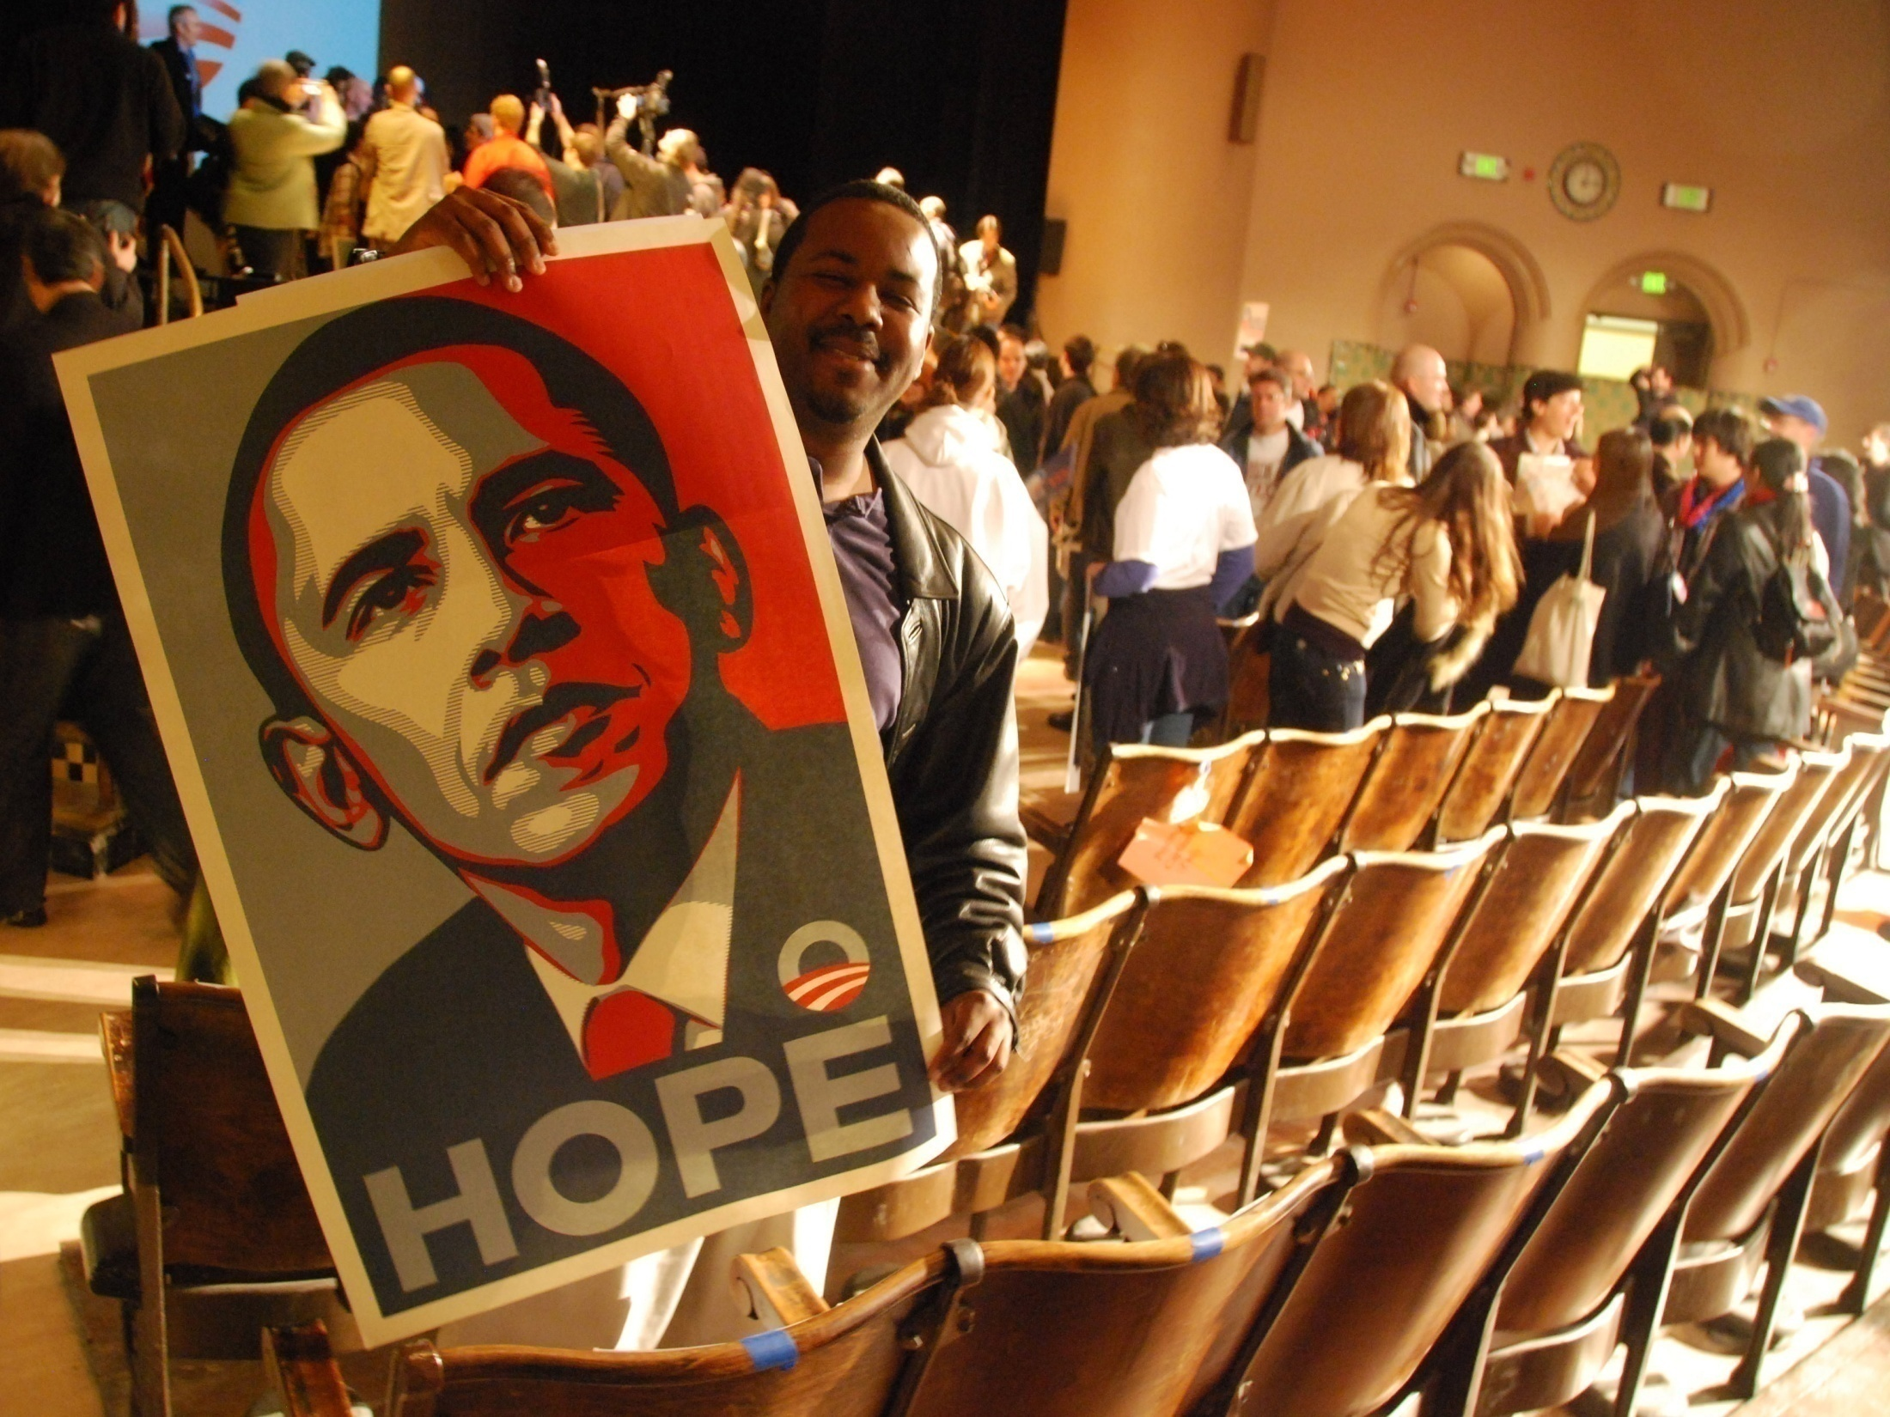
Photo by Steve Rhodes
Modern Civilization (Today)
Notes:
Out culture is still changing and being recreated everyday
Obama is biggest event in recent history

Slide 14
Core Ideas & Values
Reality- or fact-based thought and perception (Aristotle 384-322 BC)
Reason
Individualism
Happiness
Rights
Capitalism
Recognizes the right of private ownership, capital accumulation, exchange and profit
Emphasis on the individual person who is independent and self-reliant
Individuals should be able to act on their own reason without interference from others – i.e. freedom
Worldly happiness should be the focus of each person's life
Notes:
These are core ideas and values which underlie western culture

Slide 15
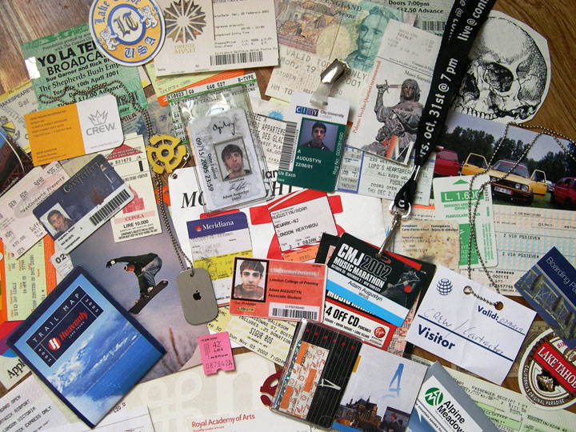
We live in a multicultural world where cultures:
Transcend geography and race (no connection)
Exist worldwide in some form (usually mixed)
Notes:
There is no one “ideal” or “best” culture
Western culture exists around the world in some form (inc. Japan, Korea & China)
Cultures can be different not only between continents or nations, but also within the same company or even family.

Slide 16

East vs. West
What’s the difference?
Illustrations by Yang Liu from “East meets West” book – www.yangliudesign.com
Notes:
What differences have you experienced?

Slide 17

Way to think
思维方式
Notes:
West: Linear (direct associations)
East: Spiral (roundabout and subtle)

Slide 18

Way of life
生活方式
Notes:
West: Individualistic, independent, values freedom
East: Group orientated, values harmony and stability

Slide 19
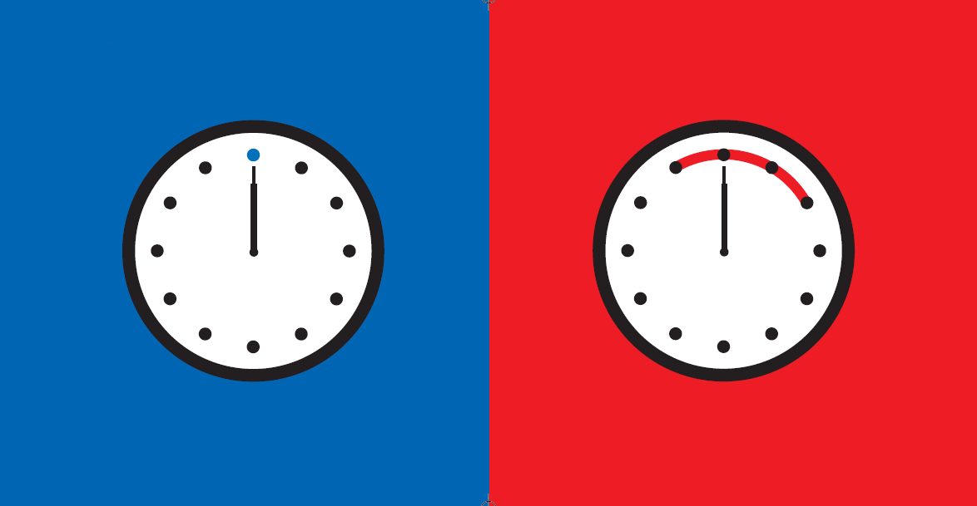
Punctuality
准时
Notes:
West: Start and end on time
East: Appointment times flexible
Don’t be late (rude). Call in advance if you can’t make it.

Slide 20
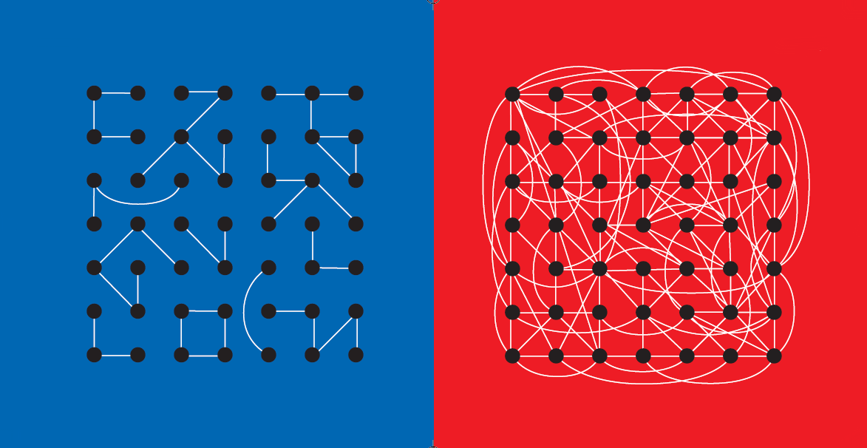
Connections
人际关系
Notes:
West: Small number of close connections
East: Highly connected web

Slide 21
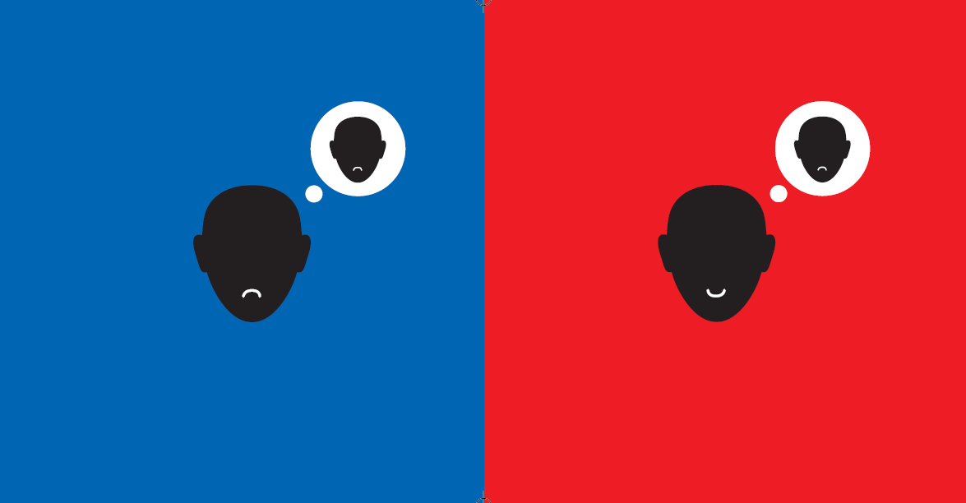
Anger
对待愤怒
Notes:
West: Argumentative, verbal
East: Difficult to say no, non-verbal
Show your feelings up front – people prefer to hear your problem before it becomes bigger

Slide 22
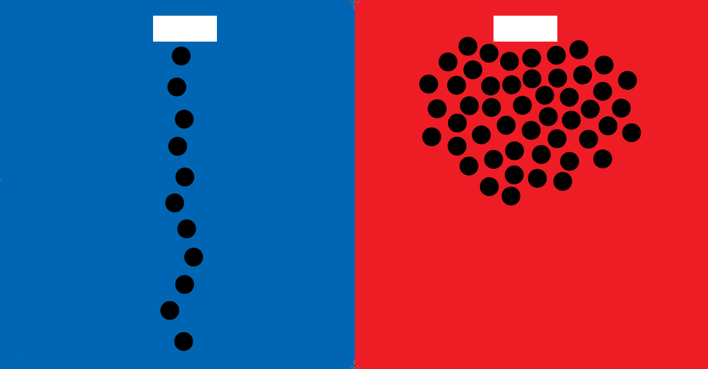
Queuing
排队
Notes:
West: Manors important (be polite)
East: Each for his/her own

Slide 23
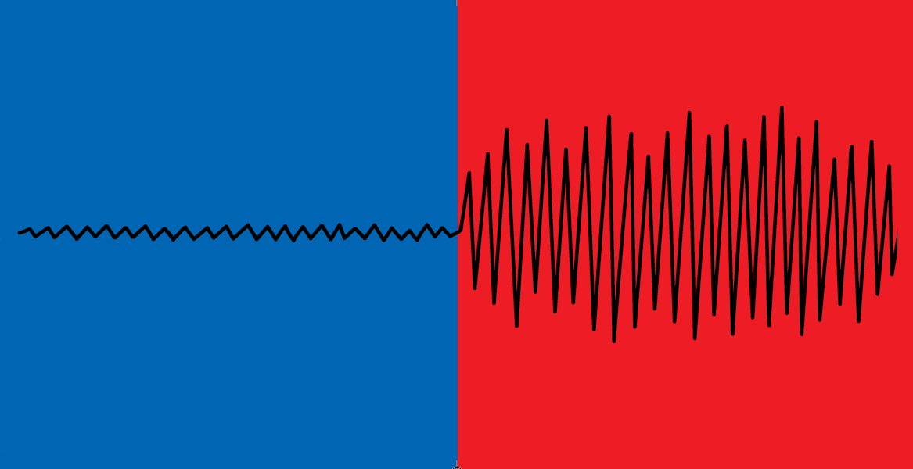
In the restaurant
在餐厅

Slide 24
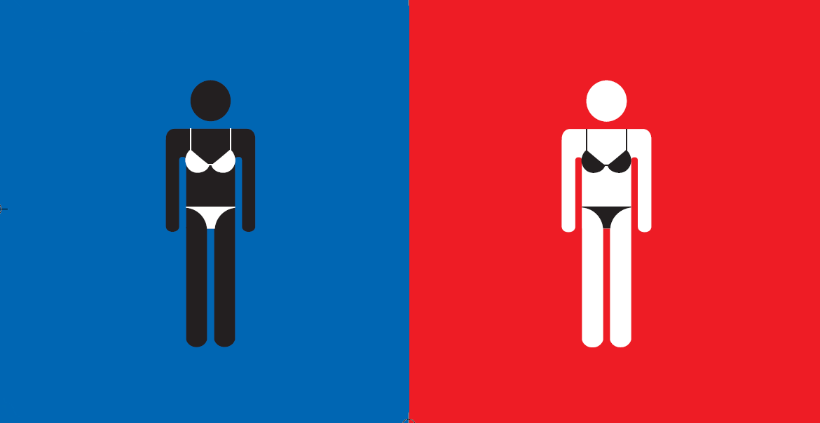
Standard of beauty
美丽的标准
Notes:
West: like dark skin
East: like white skin

Slide 25

Way to solve
problems
处理问题

Slide 26

Senior’s daily life
老人的日常生活

Slide 27

Shower time
洗浴时间

Slide 28
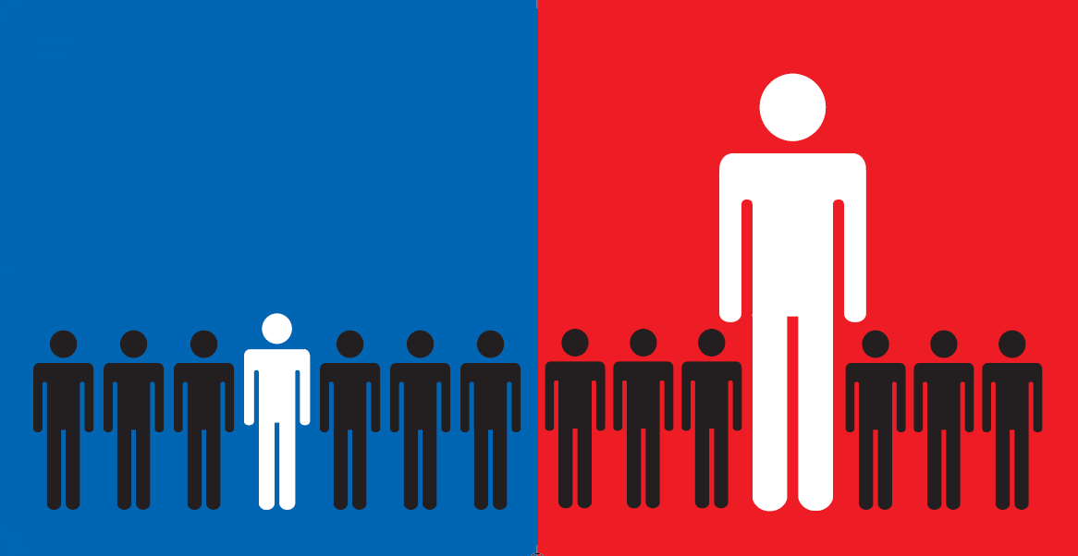
Boss
领导

Slide 29
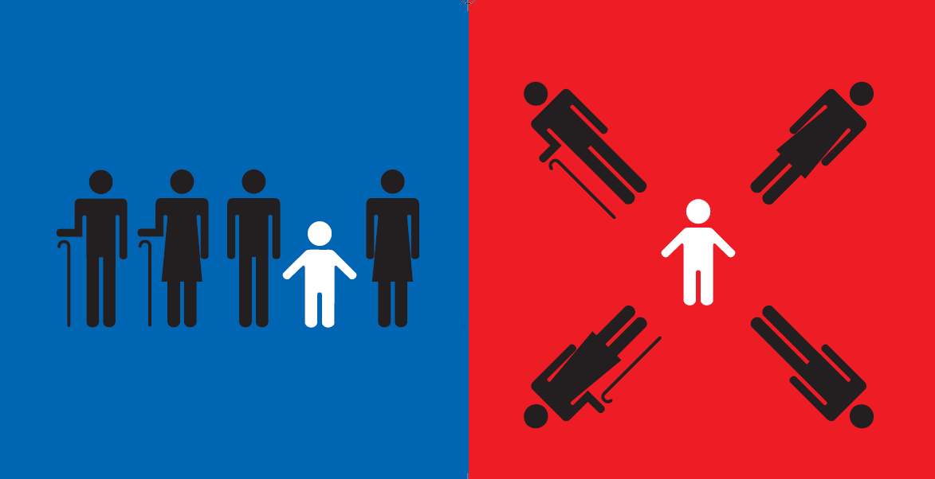
The child
孩子

Slide 30

New things
对待新事物

Slide 31
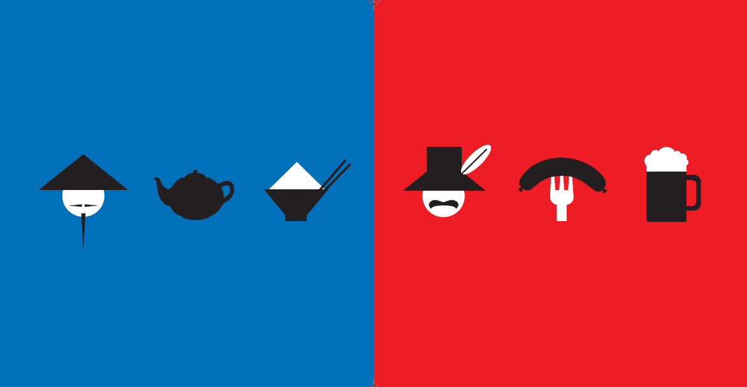
Image of each other
想像中的对方

Slide 32
Cultural Differences*
 | West (US / Europe) | East (China / East Asia)
Logic | Linear (direct associations) | Spiral (roundabout)
Communication | Direct, verbal | Indirect, implied
Identity | Individual, independent | Group orientated
Agreement / Disagreement | Argumentative, verbal | Hard to say no, non-verbal
Punctuality | Start and end on time | Appointments flexible
Respect | Success, achievement | Seniority, wisdom
Business Relationship | Economics come first | Relationship comes first
Decision Making | Distributed, proactive | Manager has final say
Time Horizon | Short term (per quarter) | Long term (years ahead)
Risk / Spending | Risk-takers, spend | Risk-avoiders, save
* but of course there are obvious exceptions

Slide 33
Intercultural Competence
Regional Experience
Openness & Tolerance
Language Proficiency
Notes:
How well you can adopt and communicate with other cultures
Intercultural competence is the ability of successful communication with people of other cultures.
Being equally comfortable in two or more cultures
A person who is interculturally competent captures and understands, in interaction with people from foreign cultures, their specific concepts in perception, thinking, feeling and acting.

Slide 34
Communicate Effectively
Speak slowly, maintain eye contact
Use objective, accurate language
Rephrase sentences where necessary
Listen carefully and patiently
Adapt your conversation style
Don’t talk down to others
Clarify what will happen next
Notes:
Culture is communication and communication is culture

Slide 35
Understand Cultural differences to help cooperate with each other
Know your neighbors
Be open and tolerant
Ask lots of questions
“When in Rome, do as the Romans do” 入乡随俗

Slide 36
In Class Assignment
36
Teams of four will spend ten minutes and the leader will present the answers to:
1. “Do in Rome as the Romans” means:
2. Five strategies for effective communication with Westerners are:
3. Americans think you speak English because:

Slide 37

Western Culture Contrasts with China
Beihang University
Professor Dave Jaye
dave.jaye55@gmail.com
www.davejaye.com
Illustrations by Yang Liu from “East meets West” book – www.yangliudesign.com
Cite: David Gilbert – Understandign Western Culture September 2009
37
Notes:
What differences have you experienced?
37

Slide 38
What is Culture?
Society
Traditions
Religion
Politics
Art & Literature
Philosophy
Science & Technology
Ethical Values
Age
Education
Social Class
Organization
Notes:
The word culture has many meanings:
In general it refers to a society's … (at a particular time and place)
Ethical Values – most cultures think killing is wrong but in some cultures in Columbia and Brazil certain tribes still practice cannibalism
Culture is learned, we are not born with it (but rather into it)
Culture changes over time (as we’ll see in a moment)
What our parent, grandparents and children think of culture will be different
Culture is more often a source of conflict than of unity
Understanding culture is the best way to avoid conflict
Language: The various languages are essentially an important part of the culture.
Norms: Every society or every civilization has a set of norms, which are an inseparable part, and an important element of the culture. This can include the folkways, mores, taboos and rituals in a culture.
Values: The social values of a particular civilization are also considered as an element of the culture. The values of a culture often refer to the things to be achieved or the things, which are considered of great worth or value in a particular culture.
Religion and Beliefs: The religion and the beliefs of the people in a civilization play an important role in shaping up of the culture as well.
Social Collectives: Social collectives refer to the social groups, organizations, communities, institutions, classes, and societies, which are considered as symbolic social constructions.
Status and Role in Society: A status or a social role is nothing but a slot or position within a group or society, which gives an overall idea of the social structure and hence is an important element of culture. This can also include traditional gender-based or age-based roles.
Cultural Integration: This includes the degree of harmony or integration within the various elements of culture. This can include elements like sub-cultures, local cultures and the difference between historical and cultural traditions.
http://www.buzzle.com/articles/what-are-the-elements-of-culture.html

